Slide 1
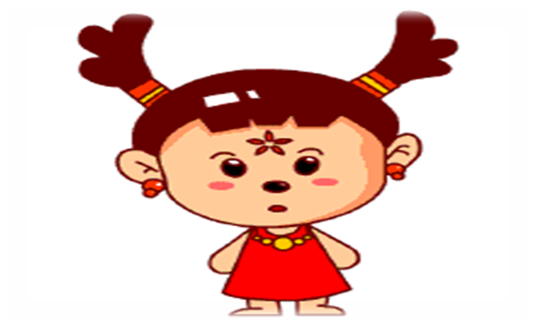
Unit 4 I have big eyes

Slide 2
Learn and say

Slide 3

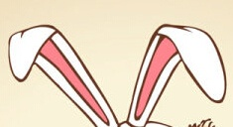
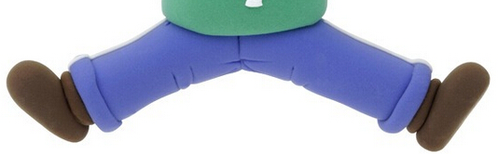

hands
ears
legs
eyes

Slide 4
Look and say

Slide 5
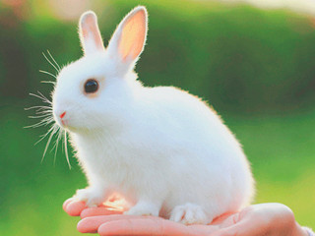
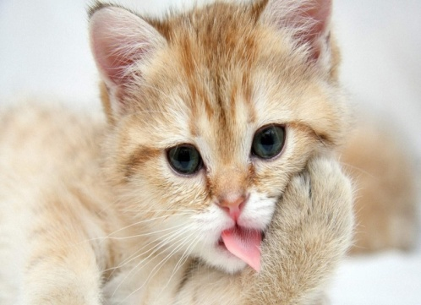
I have two ears.
I have two eyes.

Slide 6
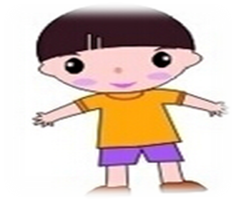

I have two legs.
I have two hands.

Slide 7
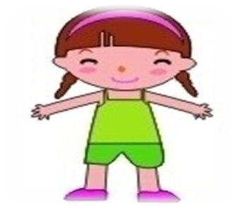
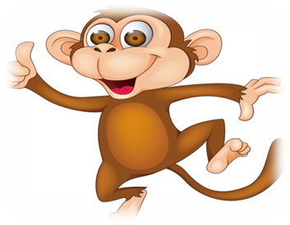
I have two arms.
I have a tail.

Slide 8
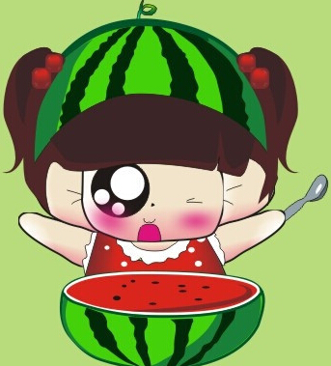

I have two arms.
I have a nose.

Slide 9
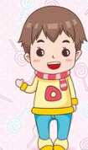
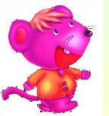
I have a small mouth.
I have a small tail.

Slide 10
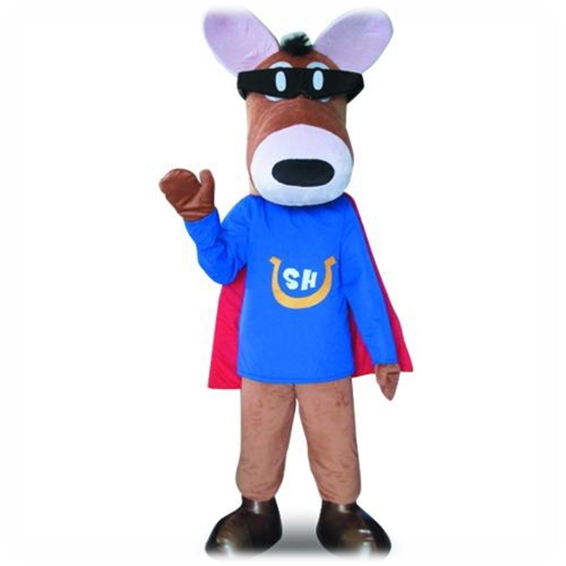
Practice
eyes
ear
hand
arm
legs

Slide 11

Homework
1. Copy the words and sentences.
two ear eye hand
I have a…
I have two…
2. Make a mini dialogue.

Slide 12
谢谢！

